Slide 1

Basics Of A - Java Program -

Slide 2

Exam Objectives
Create an executable Java program with a main class
Compile and run a Java program from the command line
Create and import packages

Slide 3
Exam Perspective
Create an executable Java program with a main class
Compile and run a Java program from the command line
Create and import packages

Slide 4
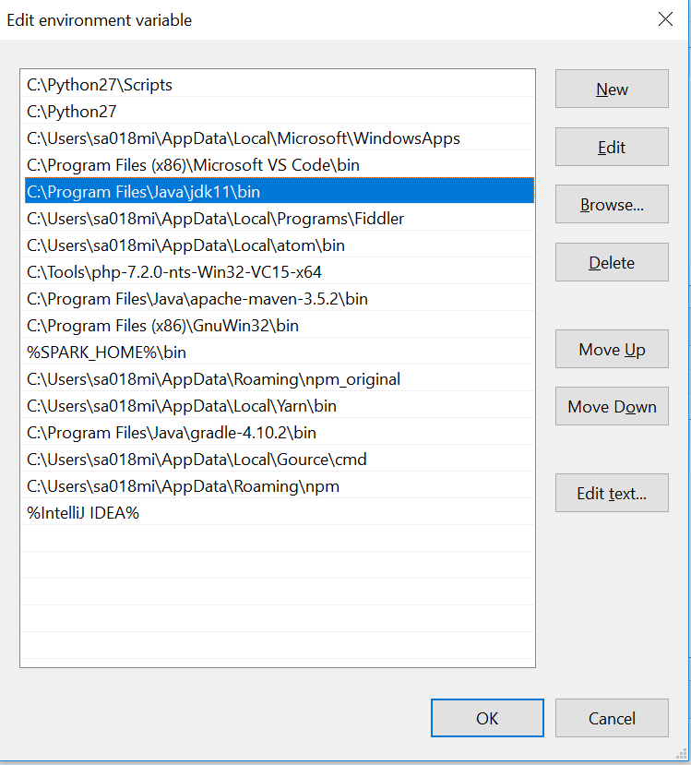
Packages
Packages are used to

Slide 5
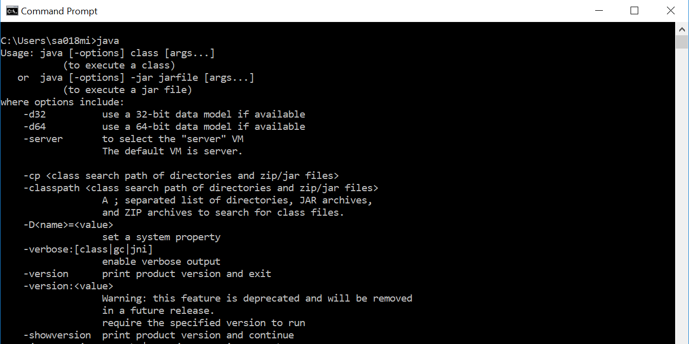
Is Java available on my system ??
Check to verify whether Java installation is installed and available from command line.

